Slide 1
CIS 7 – Discrete Structures
Lecture 14: Introduction to graph theory Part 2

Slide 2
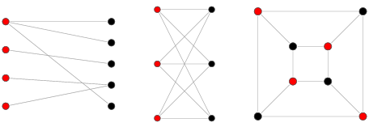
Bipartite Graph
Set of vertices broken up into two different sets so that no two vertices within the same set are adjacent.

Slide 3
Bipartite Graphs?
B
D
A
B
C
C
F
E
D
E
A
A
D
B
C
F
E

Slide 4
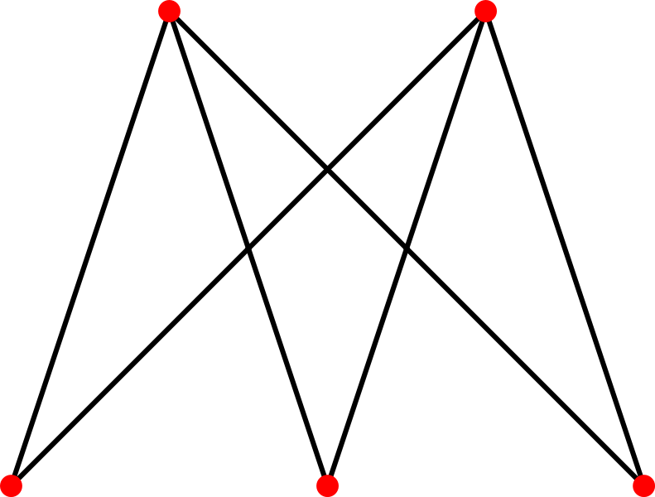
Bipartite complete Graph
A bipartite graph such that every pair of vertices in the two sets are adjacent

Slide 5
Bipartite complete Graphs?
A
B
C
A
B
C
D
E
D
E
C
B
C
B
C
A
B
A
D
A
D
D
F
E
F
E

Slide 6
Bijection
A function that maps elements between two sets, such that each element of one set is paired with exactly one element of the other set.
Examples:
{Players on a baseball team}, { Batting lineup } ?
{Students}, {Seats} (assuming # seats = # students) ?
{ Olympians }, { Olympic medalists } (assuming 1 Olympic event) ?

Slide 7

Isomorphic graph
Let G = {V,E} and G′ = {V ′ ,E′} be graphs. G and G′ are said to be isomorphic if there exist a pair of functions f :V →V ′ and g : E → E′ such that f associates each element in V with exactly one element in V ′ and vice versa; g associates each element in E with exactly one element in E′ and vice versa, and for each v∈V , and each e ∈ E , if v is an endpoint of the edge e, then f(v) is an endpoint of the edge g(e) .

Slide 8
Graph Isomorphism
Think of a graph as strings attached to thumbtacks. Now image moving the thumbtacks around without disconnecting the strings.

Slide 9
Example & game
https://illuminations.nctm.org/Activity.aspx?id=3550
http://github.ericmickelsen.com/graf/isomorphism.html

Slide 10
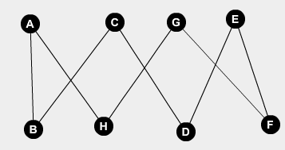
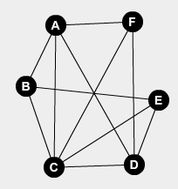
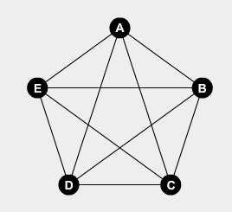
Planar graph
A graph is planar if it *can* be drawn so that it’s edges intersect *only* at nodes.
Use the program from the last slide to determine if these are planar:

Slide 11
Euler’s formula
A simple, connected, planar graph divides the entire plane into a number of regions (enclosed regions and 1 infinite exterior region). Euler observed that, the number of vertices minus the number of edges plus the number of regions is equal to 2:
|V| - |E| + |R| = 2
E
A
B
C
A
B
D
D

Slide 12
Euler
Lemma 2:
If |V| > 2, then |E| <= 3|V| - 6
Lemma 4:
If |V| > 2 AND no cycles of length 3, then |E| <= 2|V| - 4
Using this information, determine if the following are planar:
K5 (complete graph with 5 vertices)
K3,3 (bipartite graph with m = n = 3)

